Slide 1

Object Oriented Programming
Week 2

Slide 2
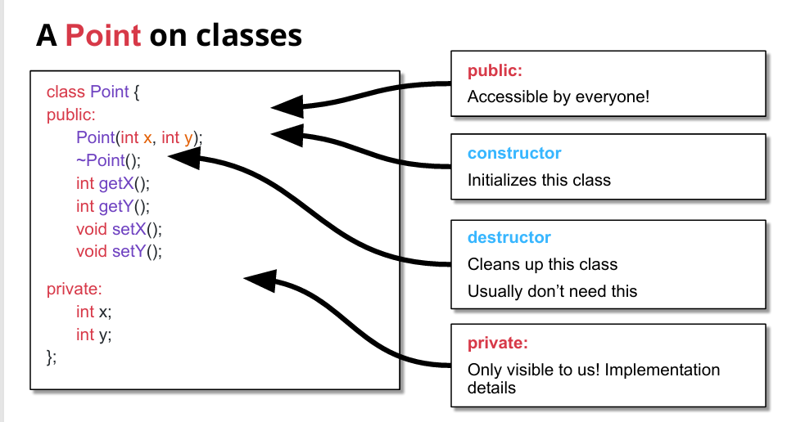
Recap

Slide 3
Think tank..!!
Student
Teacher
Staff
Name
Father Name
Address
Blood Group
Program
Semester
Name
Father Name
Address
Blood Group
Designation
Qualification
Salary
Name
Father Name
Address
Blood Group
Designation
Qualification
Salary

Slide 4
Base (Parent) Class
A base class (also called a parent class or super class) is a class that provides its attributes (data members) and behaviors (member functions) to one or more derived classes. It serves as a general template from which specialized classes can inherit properties and functionality

Slide 5
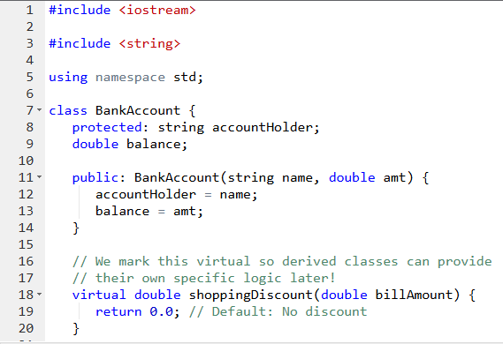

Slide 6
Derived (Child) Class
A derived class (also called a child class or subclass) is a class that inherits attributes (data members) and behaviors (member functions) from a base class. It can reuse, extend, or modify the properties and functions of the base class to implement more specialized behavior.

Slide 7
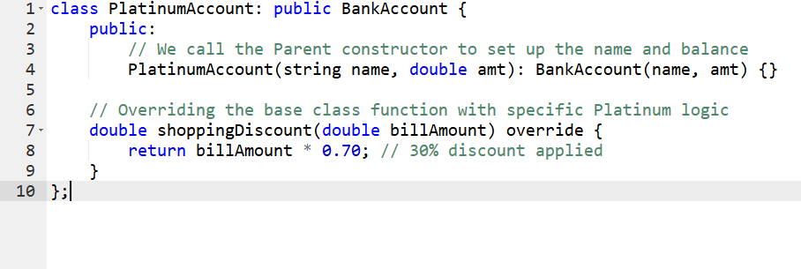

Slide 8
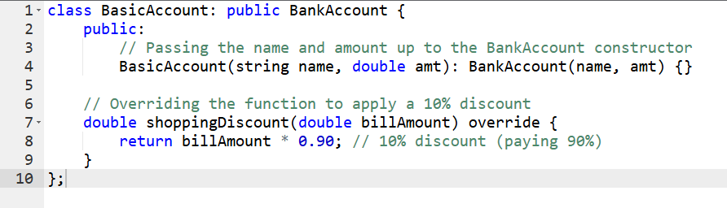

Slide 9
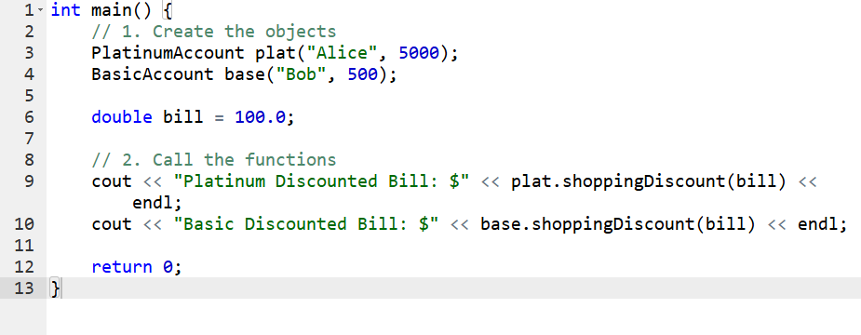

Slide 10
Access Specifiers
When a class inherits from a base class, access specifiers determine how the members of the base class are accessible in the derived class.
Base class member | Derived class access
public | public
protected | protected
private | not inherited

Slide 11
Function Overriding
Function overriding occurs when a derived class provides its own implementation of a virtual function that is already defined in its base class. This allows the derived class to modify the behavior of a function it inherits.
Only virtual functions in the base class can be overridden.
The function signature (name + parameters) in the derived class must exactly match the base class

Slide 12
Generalization
In C++, generalization is implemented through Base Classes.
You take several classes that have similar behaviors and "pull" those common features up into a single parent class.
The Goal: Code reuse. You write the code once in the base class so you don't have to rewrite it for every specific type.
Example: If you have classes for Car, Truck, and Motorcycle, you can generalize them into a base class called Vehicle

Slide 13
Specialization
In C++, generalization is implemented through derived Classes.
We want to add a new class to an existing model
Inherit the new class from this class and add unique behavior to the new class
Example: Car , Truck and Motorcycle are spelization.

Slide 14
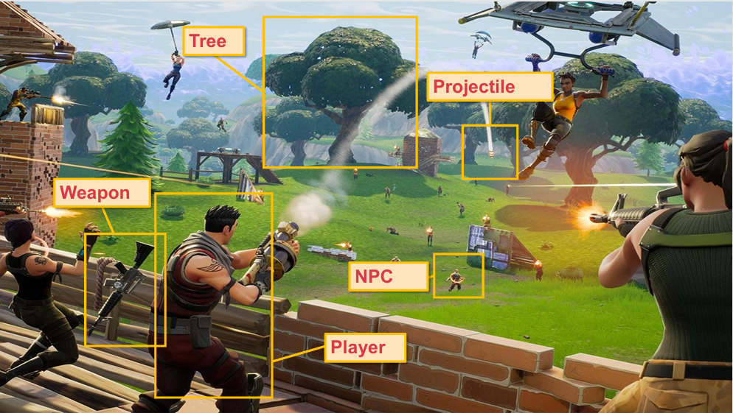

Slide 15
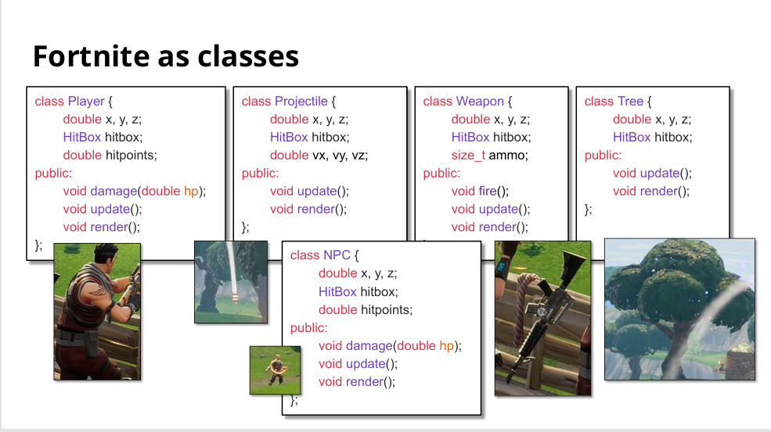

Slide 16
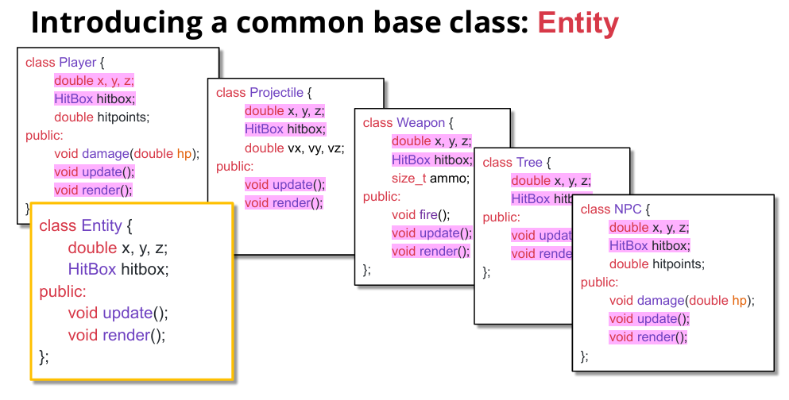

Slide 17


THANK YOU!

